Slide 1
Men’s Health @York
Notes:
LC
Welcome to inaugural event
Housekeeping

Slide 2
Session Agenda
Welcome
Tonight’s Topic - Coping With Change
The Change Curve
Three Key Questions?
The Four Doors?
Sense check to gauge lockdown ongoing meeting requirement
What are / can we do to thrive on an individual, group and community level?
Notes:
Timing:
Intro - 10 mins - LC
What have you had checked exercise - 10 mins - LC
Input re stats - 10 mins - GM
What should you get checked out exercise & at what age - 10 mins - LC
Input re what to get out checked out & when - 10 mins - GM
Common Activity Group Work - 30 mins - LC

Slide 3
Men’s Health@York
The Aim
To provide a forum to enable men to share in common activities and build relationships that enable them to talk more openly about their issues, thereby increasing their overall health.
Men, talking openly while doing activities, together

Slide 4
How it works
Series of facilitated events including talks relating to men’s health
Ongoing common interest group meeting up regularly to participate in activities,...and talk
Ongoing common interest group meeting up regularly to participate in activities,...and talk
Ongoing common interest group meeting up regularly to participate in activities,...and talk
Ongoing common interest group meeting up regularly to participate in activities,...and talk

Slide 5
Tonight’s Topic :
Coping With Change
The Change Curve
Three Key Questions?
The Four Doors?
Notes:
E.g. body parts - eyes, teeth, blood
What made you do this - Reminder sent, problems with that body part

Slide 6
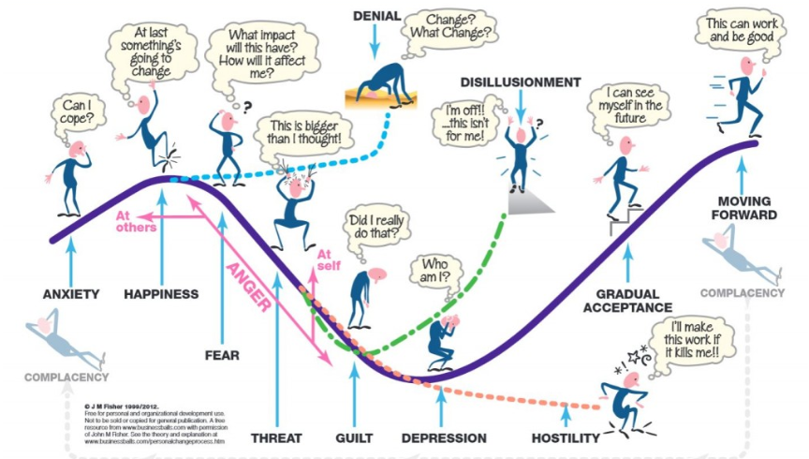
Fisher’s Change Curve
Notes:
Introduce the Fisher Curve – Lay out on the floor the rope
Describe that this comes from grief theory and as change always involves loss in some way then this is why it is applied to change.
People will journey through the change or transition curve at different pace and will likely take different paths. Some may move slowly through the first stages, others may find one area particularly attractive or sticky and stay there. Others may jump stages altogether, whilst others will visit all the stages at a pace.
At some stages there may seem contradiction for example you may have got your dream job and yet as well as excitement and happiness there is a sense of anxiety, fear or doubt.
Change, whether desired, requested or enforced will create uncertainty, you don’t know 100% what will happen you expect it to be good but…
Along the way people may become stuck or may actually leave the process altogether and yet by doing so that the start another transition curve, which may be better suite
People place themselves on the curve in answer to
When you first heard about the change?
Now?

Slide 7
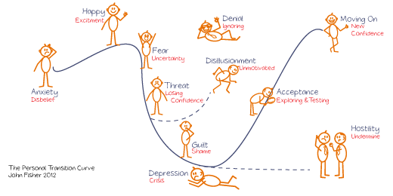

Slide 8
Looking at your change?
Negative
What is bad about this change?
What don’t you like about this change?
What do you think are the likely adverse implications?
Notes:
So the first part is to really explore the change that you have experienced from a really objective perspective. In this exercise we are going to spend time looking at this change through 3 specific lenses
Take a piece of flipchart paper and landscape create 3 columns.
The first of these is what is negative about the change. In your groups explore this question. First one person answers the questions then the next. We are looking for the anything that is negative, it may personal and different from individual to individual.
Spend 10 minutes doing this

Slide 9
Looking at your change?
Interesting
What do you need more information about?
What do you need to know others opinions about?
What options does this change open?
What could this change enable?
Notes:
Now answer these questions – keep focussed on these

Slide 10
Looking at your change?
Positive
Now what is good about this change?
What are the benefits?
What do you like about it?
Notes:
And now these for the last 10 minutes
Feedback from each group – hear each group in turn
After ask
What was it like completing that task?
What surprised you?
Which area gave you the highest challenge?
How do you feel about the change now?
Put the flipchart on the walls
Break

Slide 11
4 doors of change
Things we used to be able to do and still can do
Things we couldn’t do before and still can’t do
Things we could do before and now can’t
Things we couldn’t do before and can now
Let go
Embrace
Business as Usual
Business as usual
Jason Clarke – Embracing Change

Slide 12
4 doors of change
Things we used to be able to do and still can do
Business as Usual
Things we used to be able to do and still can do
Things we couldn’t do before and still can’t do
Things we could do before and now can’t
Things we couldn’t do before and can now
Let go
Embrace
Business as Usual
Business as usual
Jason Clarke – Embracing Change

Slide 13
4 doors of change
Things we couldn’t do before and still can’t do
Business as Usual
Things we used to be able to do and still can do
Things we couldn’t do before and still can’t do
Things we could do before and now can’t
Things we couldn’t do before and can now
Let go
Embrace
Business as Usual
Business as usual
Jason Clarke – Embracing Change

Slide 14
4 doors of change
Things we could do before and now can’t
Let go
Things we used to be able to do and still can do
Things we couldn’t do before and still can’t do
Things we could do before and now can’t
Things we couldn’t do before and can now
Let go
Embrace
Business as Usual
Business as usual
Jason Clarke – Embracing Change

Slide 15
4 doors of change
Things we couldn’t do before and can now
Embrace
Things we used to be able to do and still can do
Things we couldn’t do before and still can’t do
Things we could do before and now can’t
Things we couldn’t do before and can now
Let go
Embrace
Business as Usual
Business as usual
Jason Clarke – Embracing Change

Slide 16
4 doors of change
Things we used to be able to do and still can do
Things we couldn’t do before and still can’t do
Things we could do before and now can’t
Things we couldn’t do before and can now
Let go
Embrace
Business as Usual
Business as usual
Jason Clarke – Embracing Change

Slide 17
Sense check to gauge lockdown ongoing meeting requirement
Frequency | Fortnightly | Monthly | Bimonthly
Timing | Day time | Early Evening | Late Evening
Suggested Lockdown Topics

Slide 18
What are we doing to thrive on an individual, group and community level?
Individual Level | Group Level | Community Level

Slide 19
How can we facilitate action on an individual, group and community level?
Individual Level | Group Level | Community Level

